Slide 1
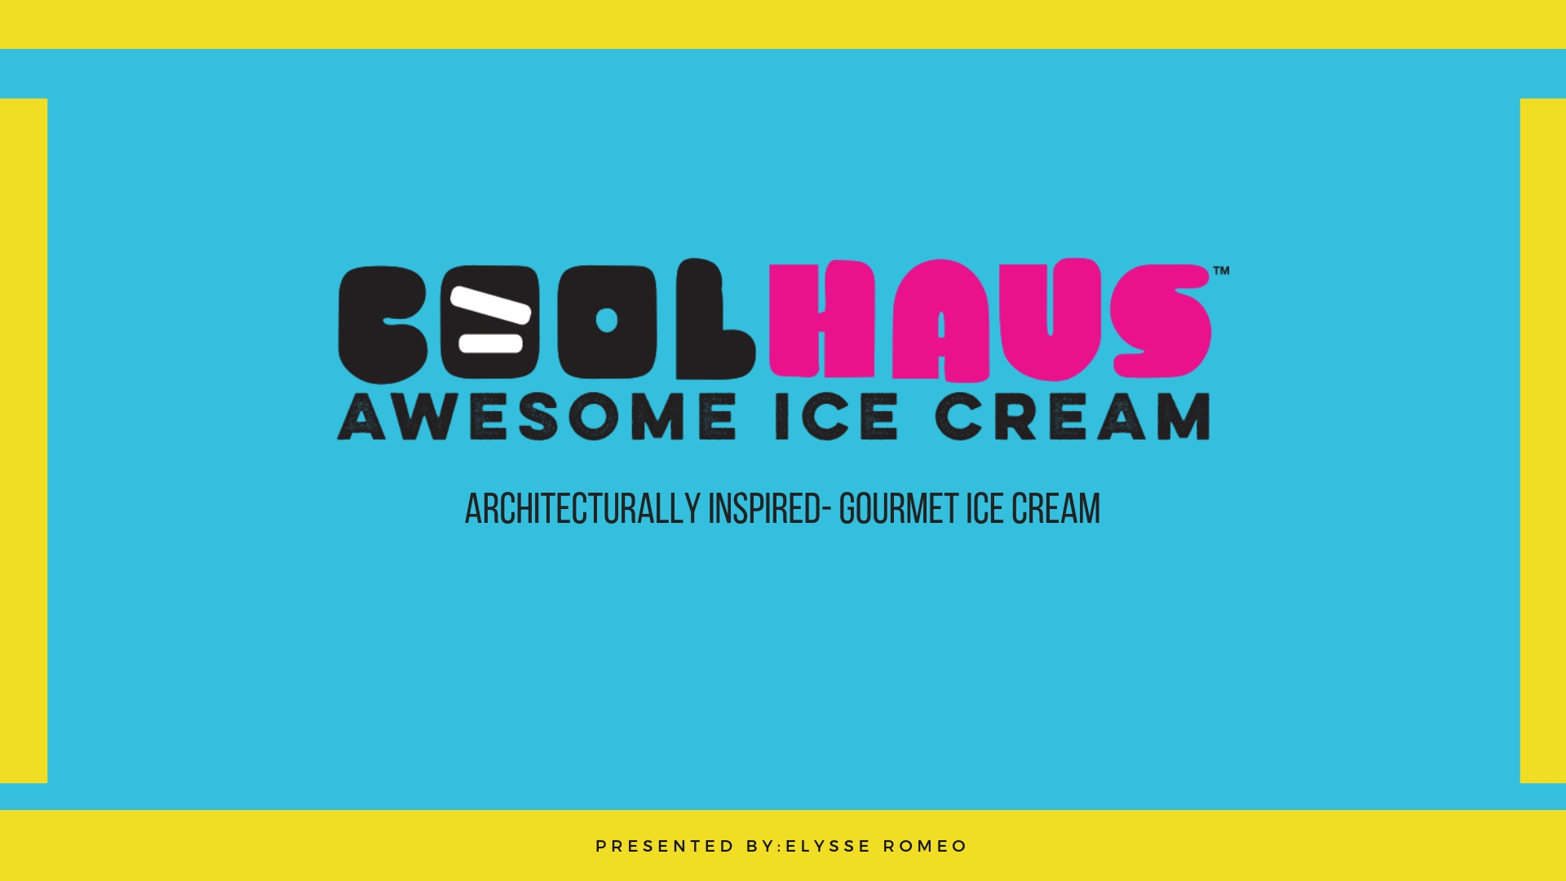

Slide 2
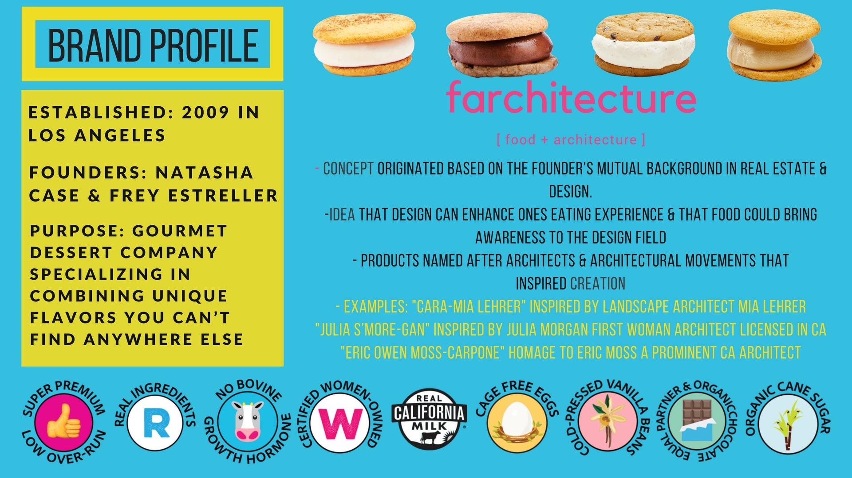

Slide 3
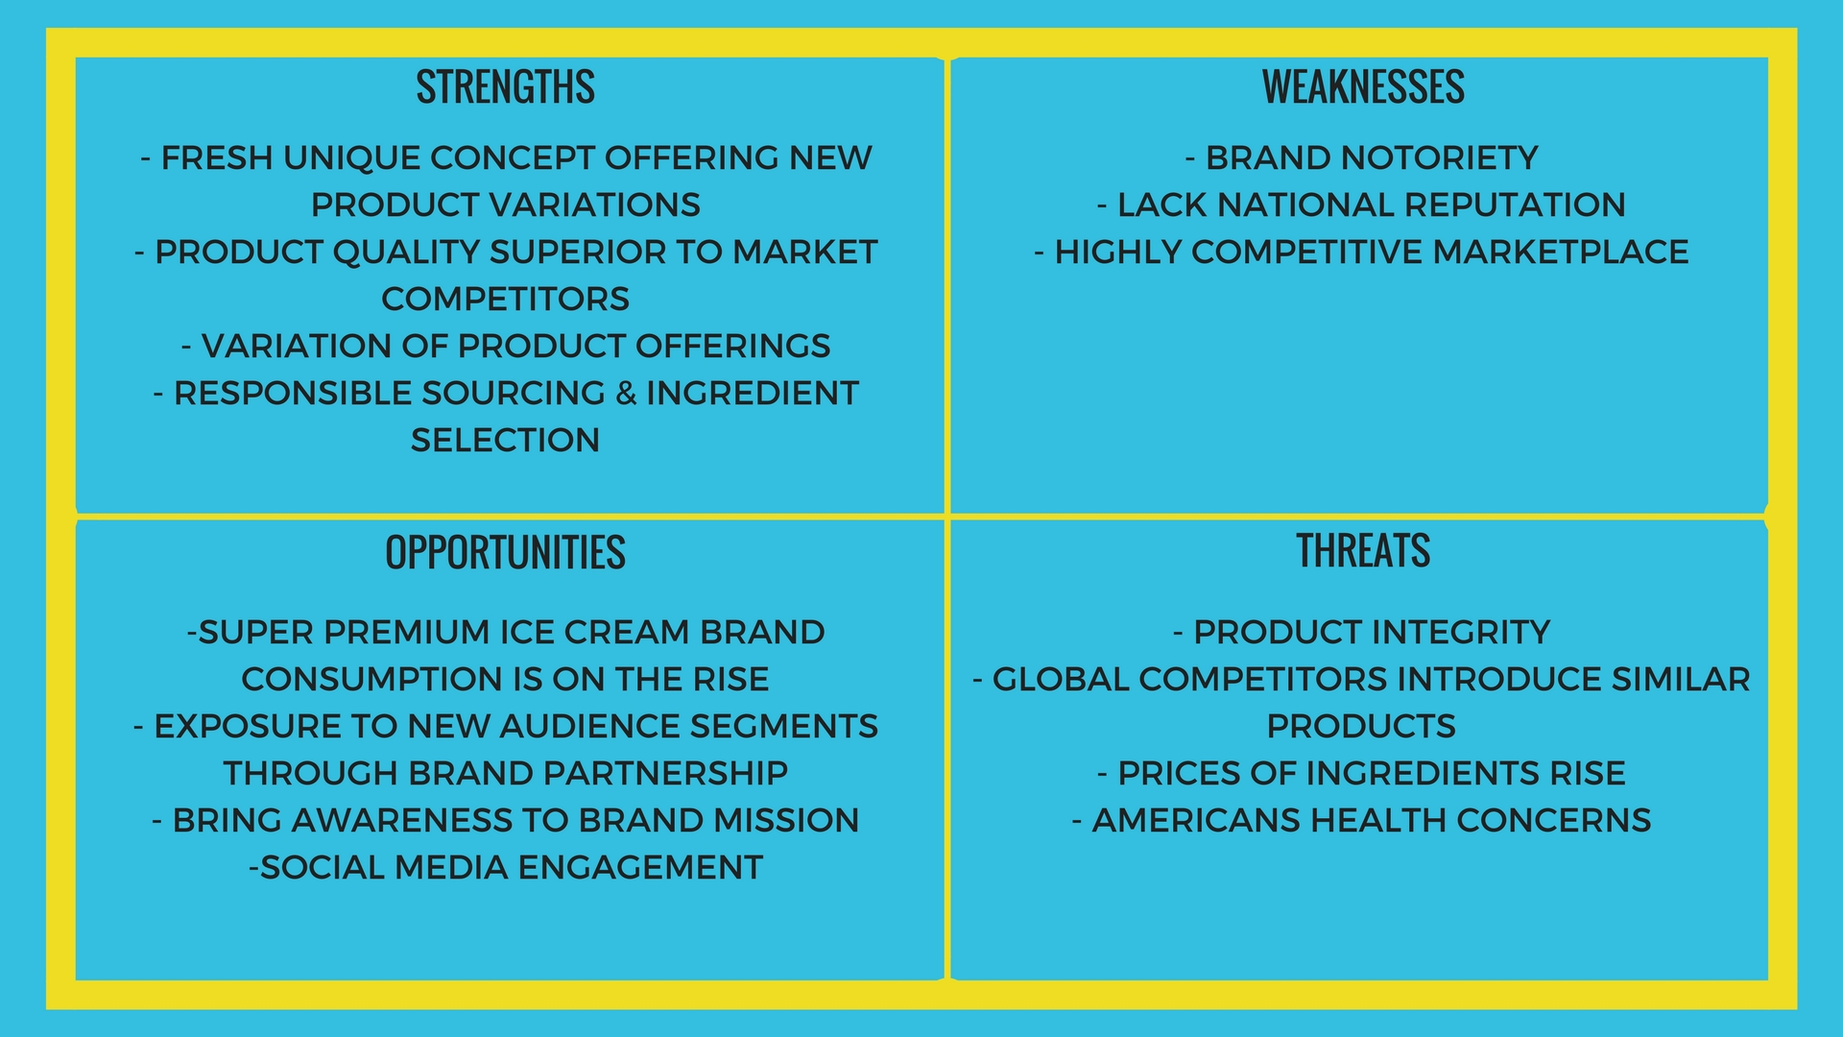

Slide 4
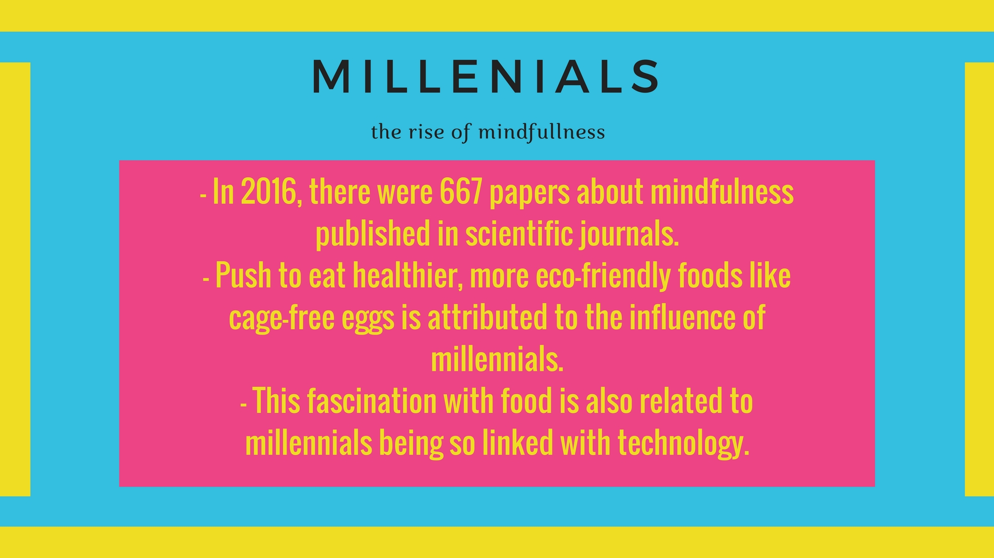

Slide 5
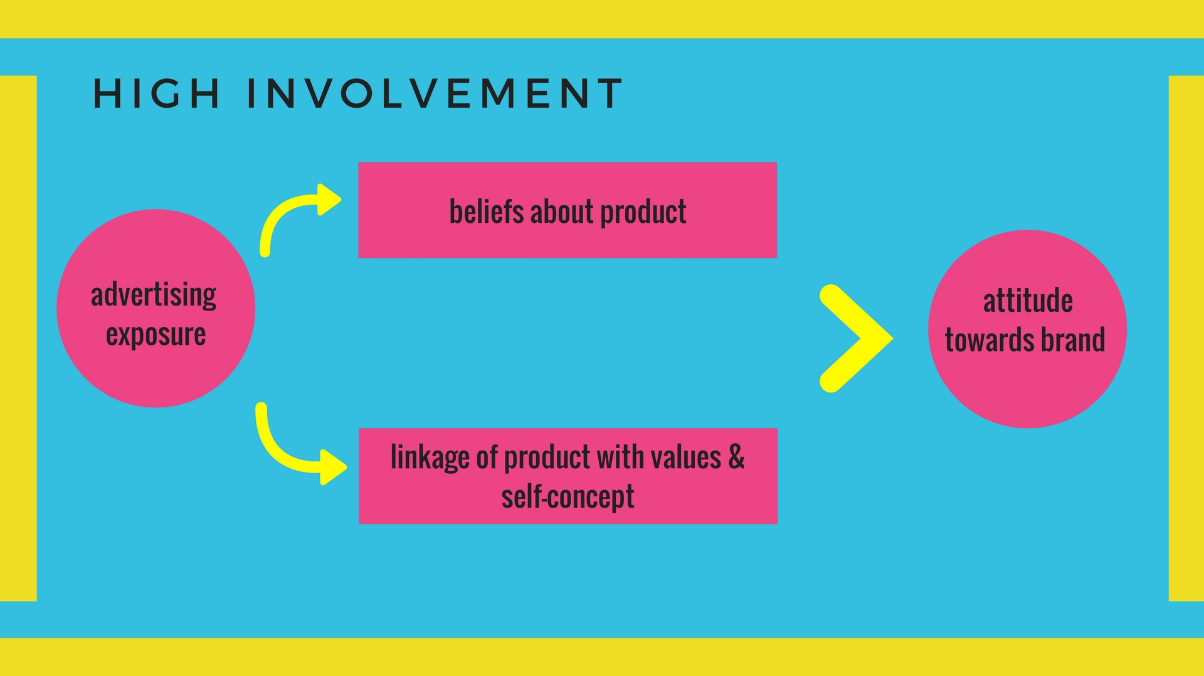

Slide 6


Slide 7

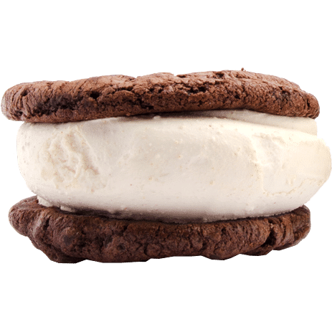
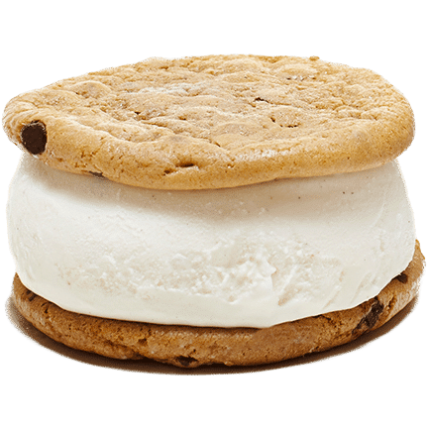
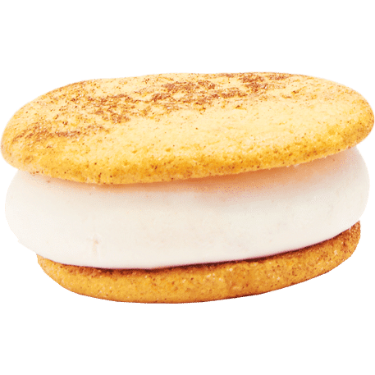
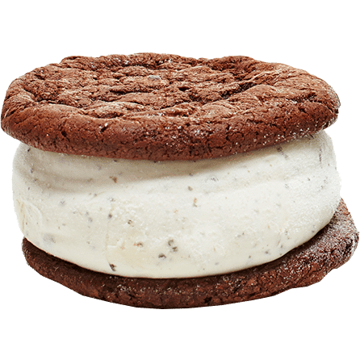
Pilot Study
12 question survey
Targeting Millennials
We had interesting results

Slide 8
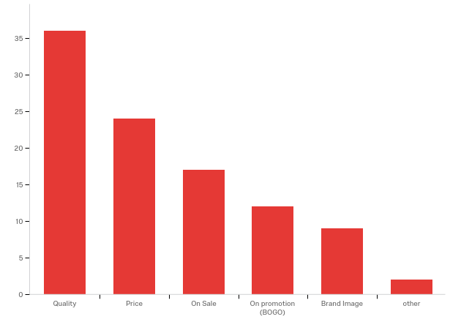
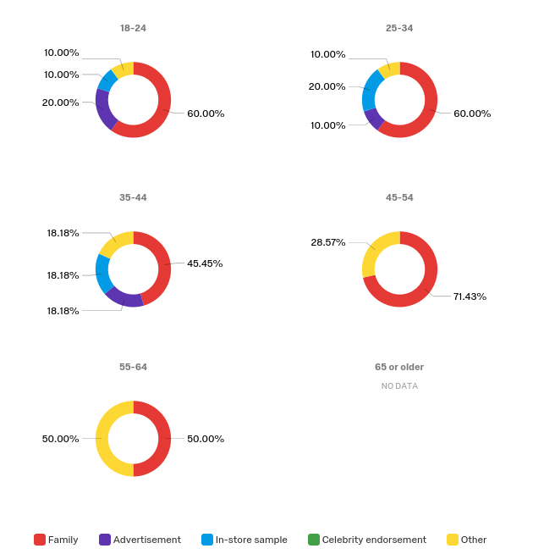
Results
63% female 37% male
Quality

Slide 9
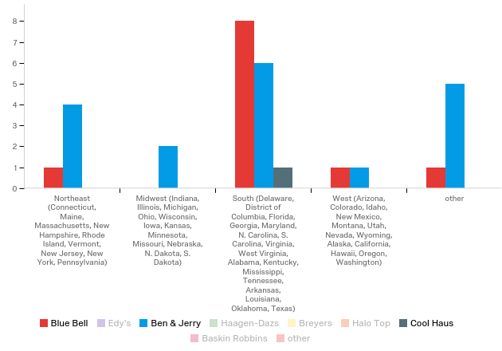
Results

Slide 10
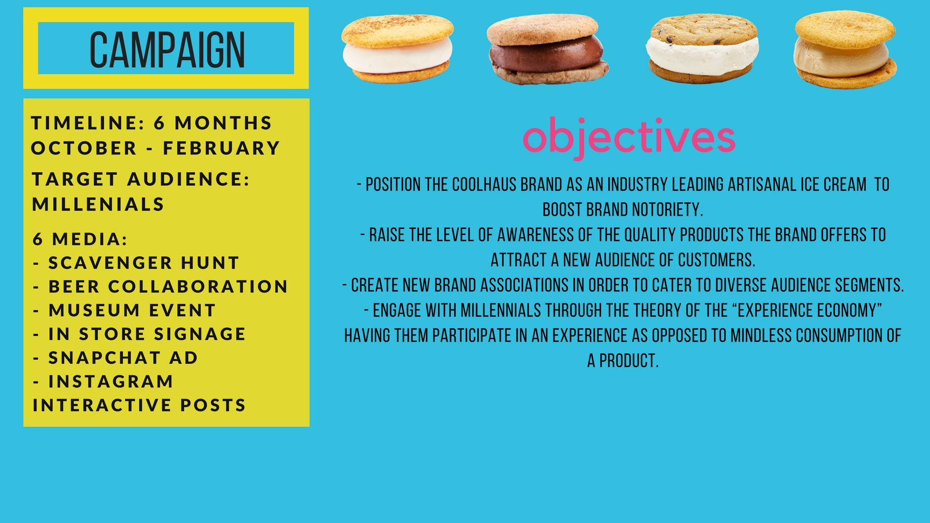

Slide 11
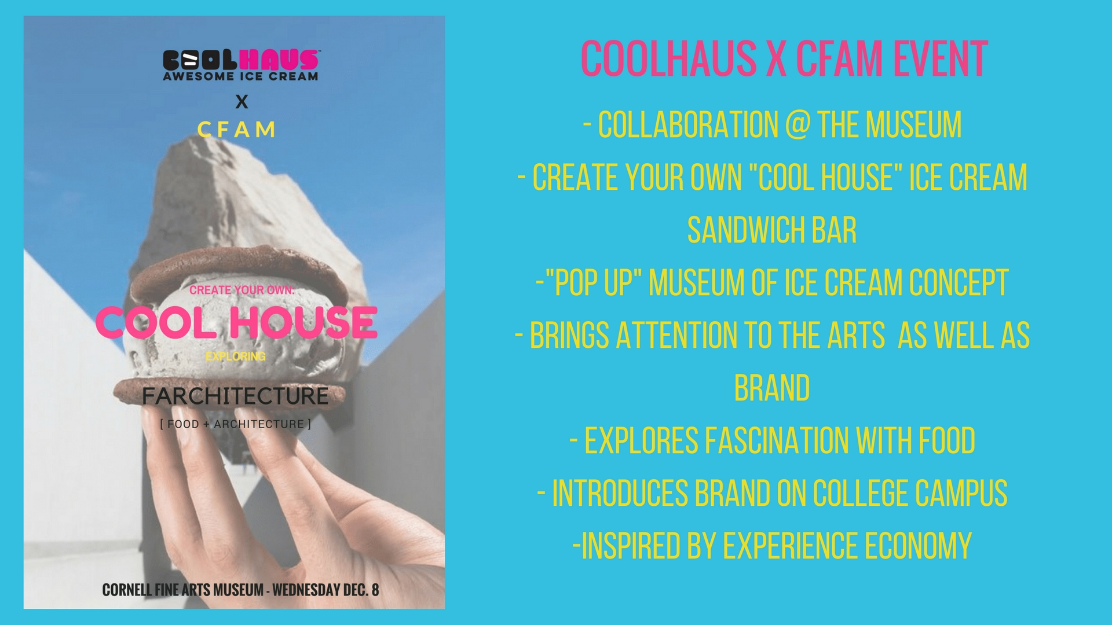

Slide 12
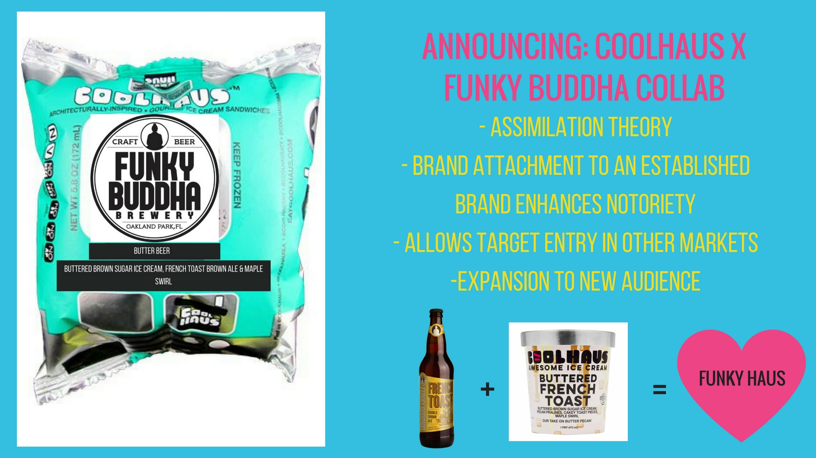

Slide 13
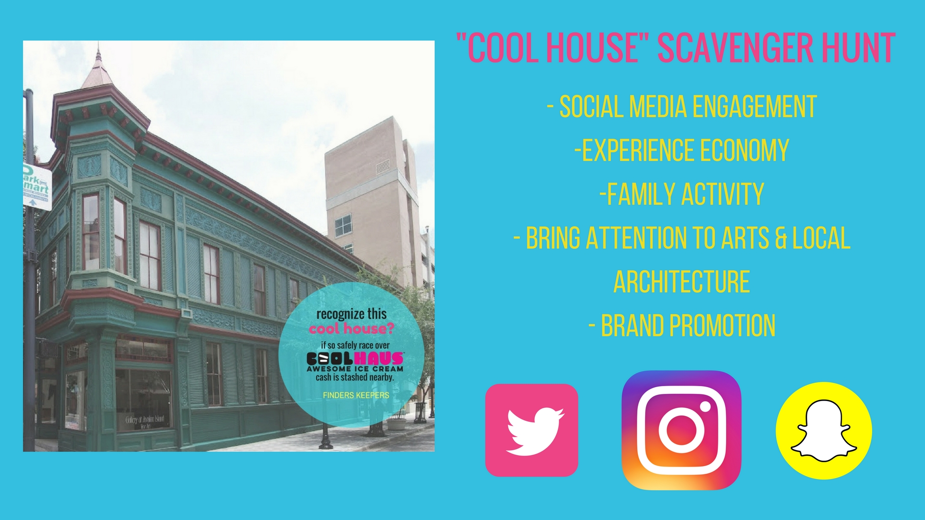

Slide 14

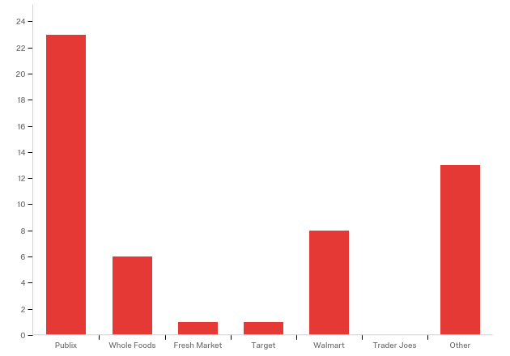
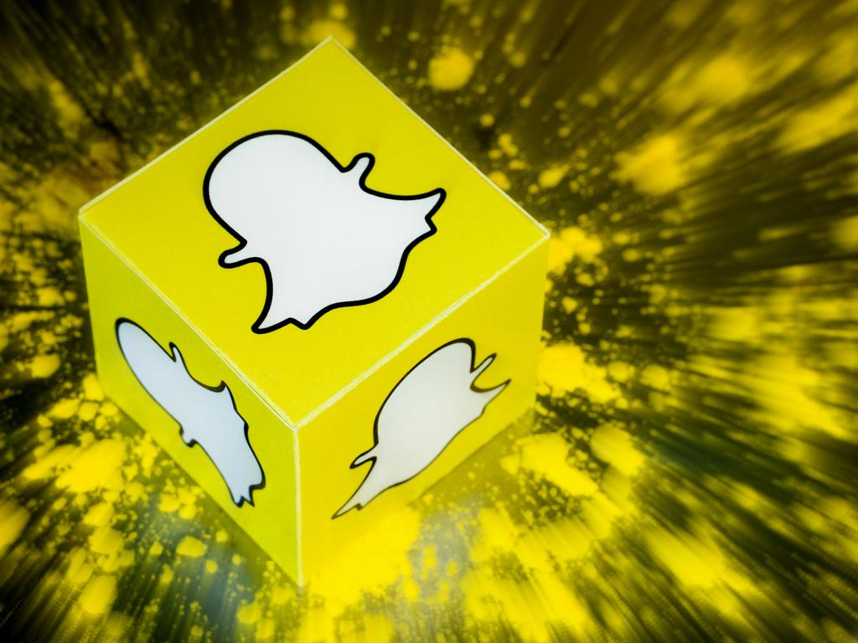
ALTERNATIVE Media Sources for marketing
Instagram
5 second ad
Shoppers prefer Publix. We will introduce prints near the product for marketing.

Slide 15
REFERENCES
Howe, N. (2017). [Forbes]. Retrieved 18 November 2017, from https://www.forbes.com/sites/neilhowe/2017/03/17/how-generations-meditate-on-mindfulness/#4965343e39d1
Perloff, R. M. (2014). The Dynamics of Persuasion Communication and Attitudes in the 21st Century (5th ed.). New York: Routledge.
Williams, G. (2017). [Forbes]. Retrieved 19 November 2017, from https://www.forbes.com/sites/geoffwilliams/2016/12/31/how-millennials-will-shape-food-in-2017/#70ec2e316a6d
Taylor, K. (2014, April 17). How the Coolhaus Founder Stayed Chill as One Food Truck Became a Frozen Treat Empire. Retrieved December 01, 2017, from http://www.nbcnews.com/id/54975217/ns/business-small_business/t/how-coolhaus-founder-stayed-chill-one-food-truck-became-frozen-treat-empire/#.WgmrqBOPK34
About Coolhaus. (n.d.). Retrieved December 01, 2017, from https://cool.haus/about-coolhaus/
Kehrer, D. (2017, February 21). 10 Steps to Marketing Plan Success. Retrieved December 01, 2017, from https://www.thryv.com/blog/10-steps-to-marketing-plan-success/

